Slide 1
LENDING CLUB CASE STUDY
Anshul Khadse

Slide 2
Problem Statement
Problem Statement
Lending Club
Objective
Lending Club is the largest
online loan marketplace,
facilitating personal loans,
business loans, and
financing of medical
procedures. Borrowers can easily access
lower interest rate loans
through a fast online
interface.
Lending Club wants to
understand the driving
factors behind loan default, i.e., the driver variables which are strong indicators of default.
The company can utilize this knowledge for its portfolio and risk assessment.
As a data scientist working for Lending Club analyze the dataset containing information about past loan applicants using EDA to understand how consumer attributes and loan attributes influence the tendency of default.

Slide 3
Analytical Approach
Data Cleaning
Segmented
Univariate
Analysis
Summarize
Results
Columns with 80% or more missing values, all random values, or a single value column should be removed.
Convert values to the appropriate int, datetime and float representations
Analyze variables against segments of other variables
Create derived variables
Summaries the key factors helps in detection of Defaulters
Publish the results
2
4
1
3
5
Univariate
Analysis
Bivariate
Analysis
Check distributions , frequencies and count of various numerical and categorical variables
Create derived variables through binning
Do correlation analysis
Check how two variables affect each other
Analyze joint distributions

Slide 4


Data Provide By Lending Club
Lending Club data is broadly classified into three categories, as shown in the table below, and columns under each category are also shown below:
Applicant Information
Loan Amount & Interest Rate
Applicant Behaviors
Grade
Sub-Grade
Employment Title
Employment Length
Home Ownership
Annual Income
Purpose
Address
Loan Amount
Funded Loan Amount
Term
Interest Rate
Installment
Loan Status
Open Account
Revol Balance
Deling_2yrs
earliest_cr_line
inq_last_6mths
total_acc
total_pymnt_inv
last_pymnt_d
last_pymnt_amnt
last_credit_pull_d

Slide 5
DATA CLEANING
Lending Club provided us with a dataset that included 39717 records and 111 columns.
We discovered 56 columns with more than 80% missing values after analyzing the missing values percentage from each column.
Columns with 80% or more missing values are excluded from further analysis.
Columns containing information about customer behaviors, such delinq_2, earliest_cr_line, recoveries, out_prncp, total_acc, last_pumnt_amnt and so on, are also excluded from analysis.
The goal of this study is to identify the factors that assist clients in determining defaulters because these above-mentioned characteristics are only known to clients after loan approval and thus cannot be useful in our analysis.
We also found out that there are some column hold single value for all records. There were total 9 columns which show this pattern; hence we exclude them from our analysis.
Column such as “int_rate” and “issue_d” are in string formate. We convert “int_rate” to float and derived “issue_d_month” and “issue_d_year” column from “issue_d” column.
Rows with loan status “Current” were also removed as they were irrelevant to the purpose .

Slide 6
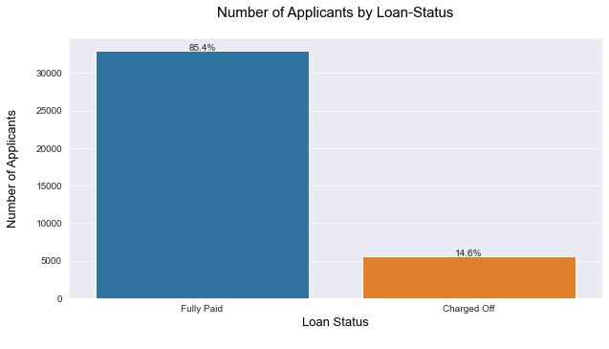
Data Understanding
There are 38,577 applicants in all.
The number of defaulter applications is 5827.
The default rate is 14.6%.

Slide 7
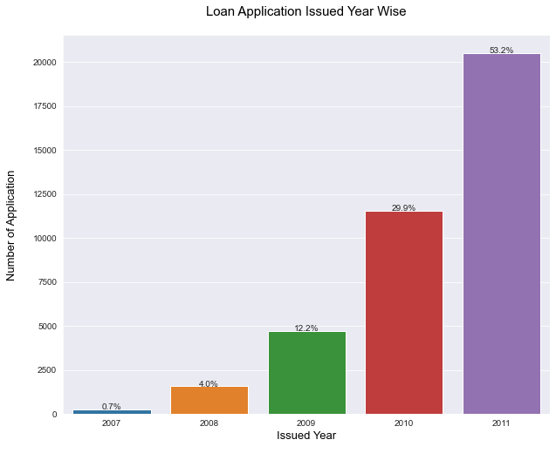
Year wise Application Distribution
The number of application for loan are drastically increasing every year
In 2011 there is 78% increase in application compared to 2010
Similarly, there is 145% increase in application from 2009 to 2010

Slide 8
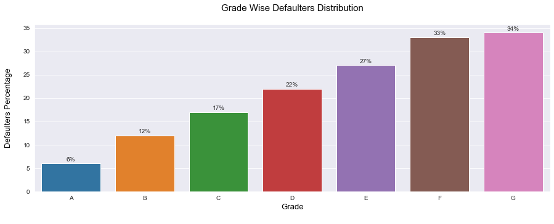
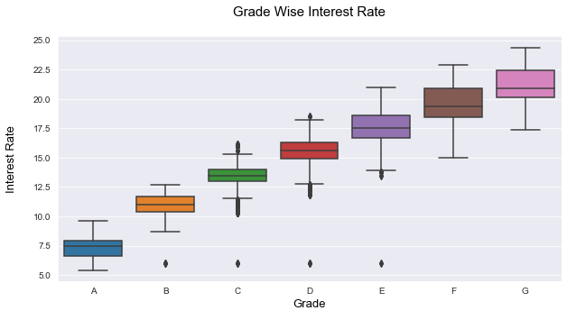
Effect of Grade on Defaulters
For grade G and F has high percentage of defaulter i.e 34% and 32% respectively
Lower grades have high chance of defaulter
Lending Club charges higher interest rates as the grade of loan becomes worse

Slide 9
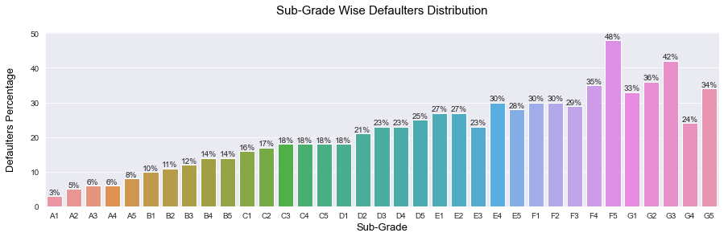
Effect of Sub Grade on Defaulters
Grade F5, G3 and G5 has high number of defaulters
As the sub grade increases from A to G the percentage of defaulters are also increasing this is due to high interest rate on lower grades

Slide 10
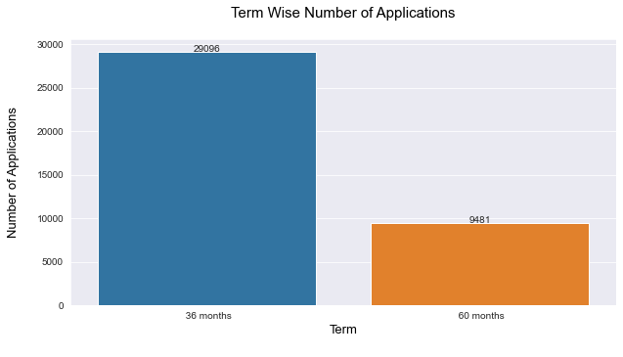
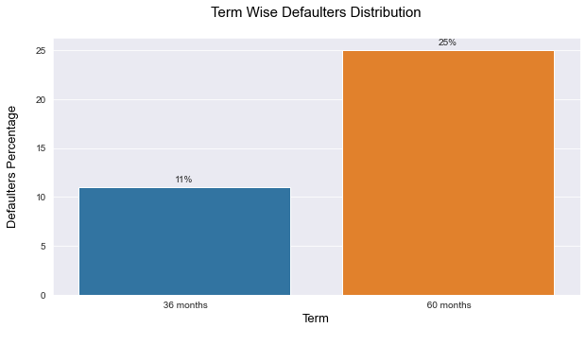
Effect of Term on Defaulters
According to the left graph, more loan applications are for Short-Term loans, and 29,096 of total applications are for Short-Term loans.
However, the rate of defaulters is higher in the Long-Term. As compared to the Short-Term, it is more than double. As a result, Long-Term applicants are more likely to default.

Slide 11
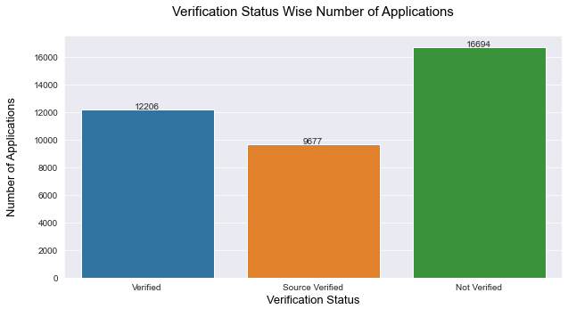
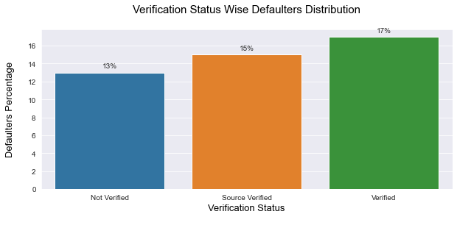
Effect of Verification Status on Defaulters
From left chat we can clearly see that number on “Not Verified” applications are more than “Verified” and “Source Verified”
Surprisingly, right chart show that the percentage of defaulter is more in “Verified” category

Slide 12
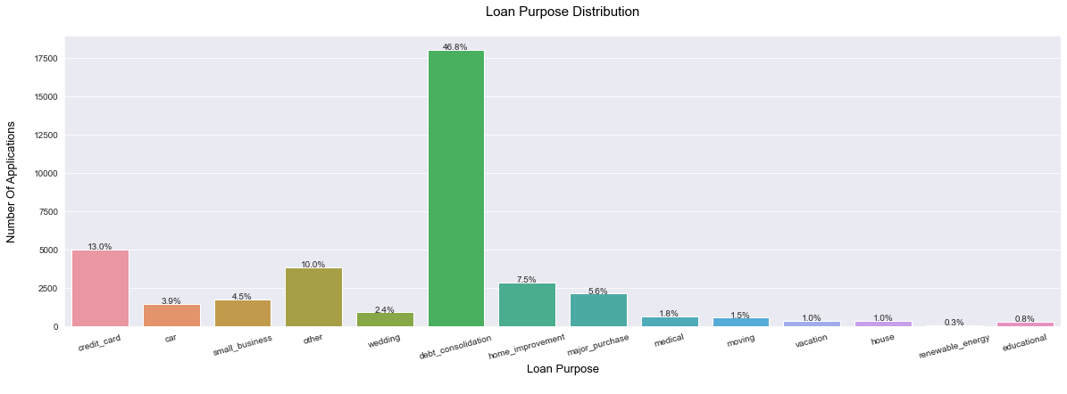
Purpose for Loan Application
The 40.8% of loan application is for “debt_consolidation” purpose
Other than that, 13% are for “credit_card” and 7.5% are for “home_improvement” are some major purpose

Slide 13
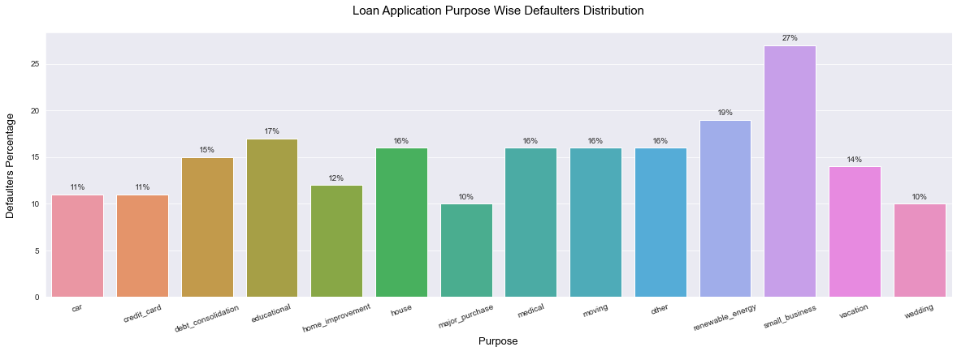
Effect of Loan Purpose on Defaulters
“small_business” has around 27% of defaulter which is heights among all other categories
“education” has 17% of defaulter which is 2nd height among the list
More than a quarter of loans taken for the purpose of running a “small_business” see defaulters.

Slide 14
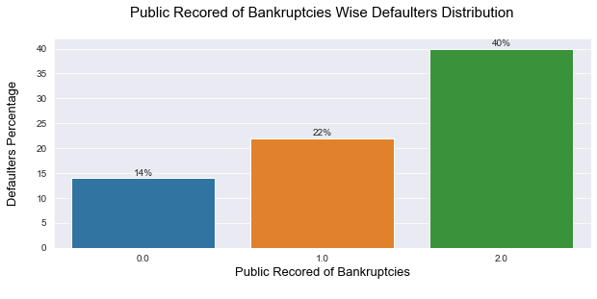
Public Record of Bankruptcies
Applicant having prior record of bankruptcies are more likely to be defaulters
Hence extra care needs to taken while approving loan for such applicants

Slide 15
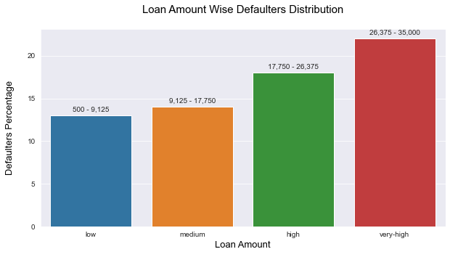
Effect of Loan Amount on Defaulters
Value above bar indicating the range of value info different category
Loan Amount 500 to 9,125 belong to “low” bins
Clearly, we can see the trend that as the loam amount increases the percentage of defaulter is also increase

Slide 16
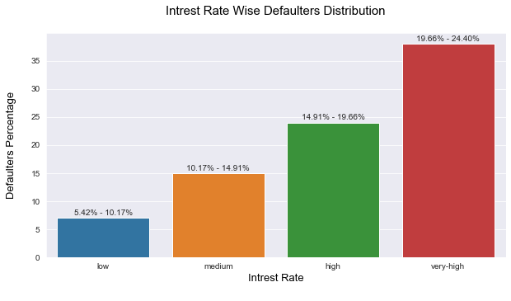
Effect of Interest Rate on Defaulters
Value above bar indicating the range of interest into different category
Interest rate 10.17% to 14.91% are represented by “medium” category
As the rate of interest increases the chance of applicant being defaulter is also increase

Slide 17
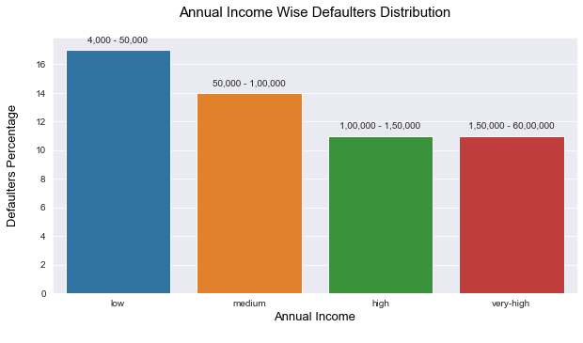
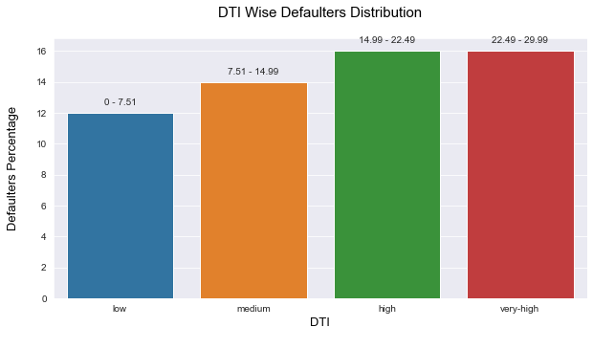
Effect of Annual Income & DTI on Defaulters
Lower the annual income higher the percentages of the defaulter
Higher the DTI higher the chance of applicant is defaulter

Slide 18
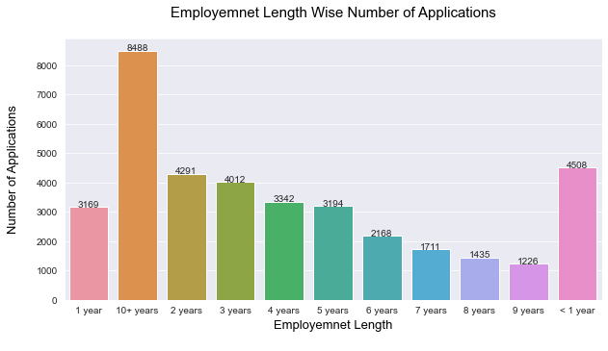
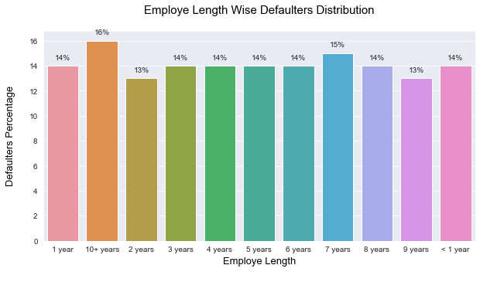
Effect of Employment Length
Majority of employees applying for the loan have more than 10 years of experience
Tendency of person to default the loan with 10 years of experience is also high. So, company need to be careful when granting loan.

Slide 19
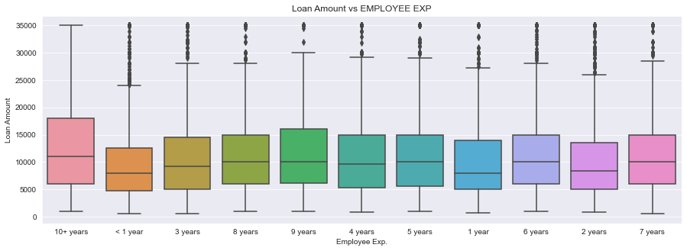
Loan Amount vs EMPLOYEE EXP
By doing bivariate analysis it has been observed that the employee exp. With 10+ years is taking more amount of loan
Those who are less than 1 year is taken less amount of loan

Slide 20
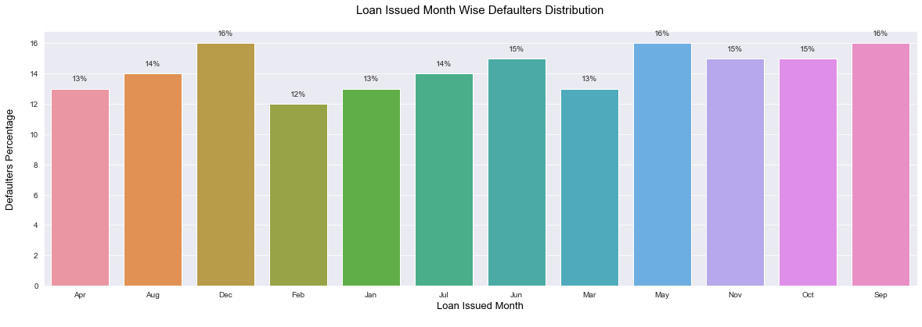
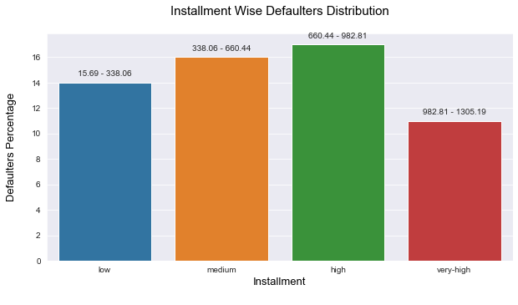
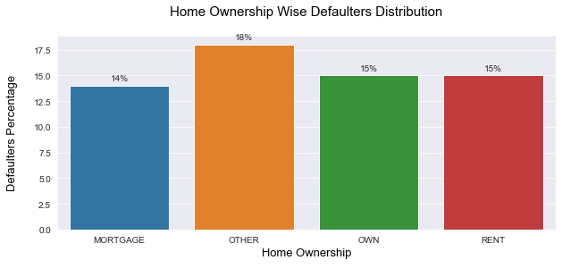
Feature Which has No major Impact on Defaulter
Home Ownership
Loan Issued Month
Installments

Slide 21
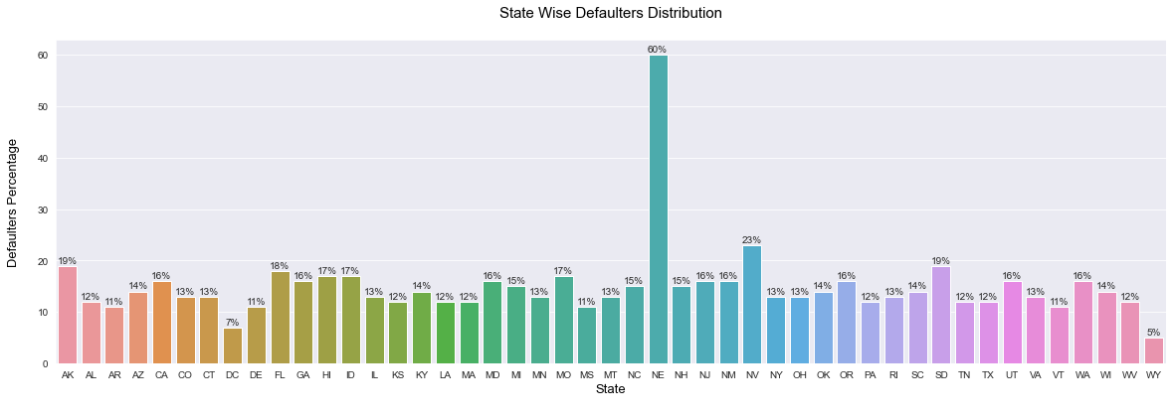
Effect of Location on Defaulters
NE state has highest numbers of defaulters which is around 60%
Followed by NV which has 23% and SD and AK has 19% of defaulters

Slide 22
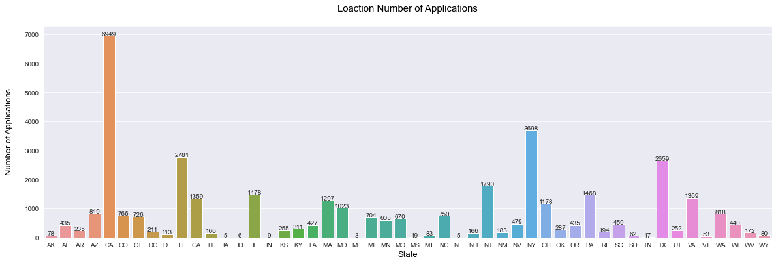
Loan Given State Wise
The loans which are given for CA, NY, FL,TX state are more than any other state.

Slide 23
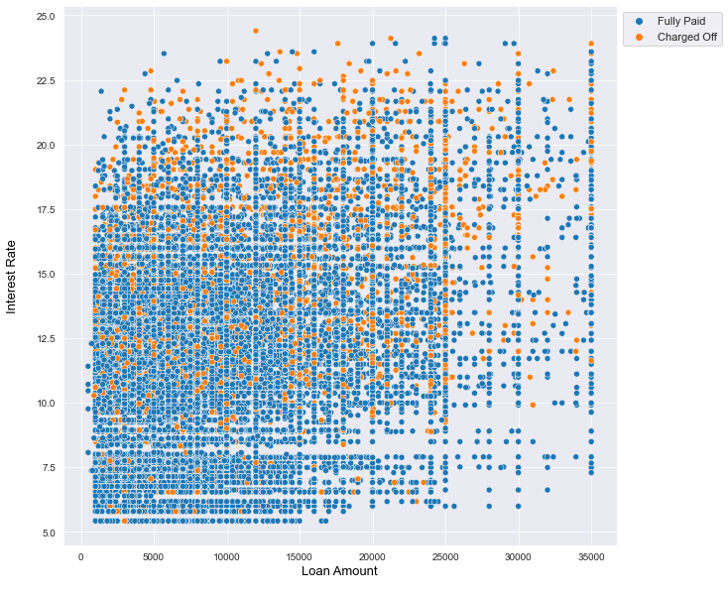
Loan amount vs interest rate for Loan Status
Even if the loan amount is low but the interest rate is too high then the count of charged off customers are more than fully paid.
For loan amounts above 25000, approved applications for loans have decreased significantly.
For loan amounts greater than 25000 and interest rate above 15% people mostly charged off than fully paid .
To reduce defaulter high interest rate on lower loan amount should be avoid

Slide 24
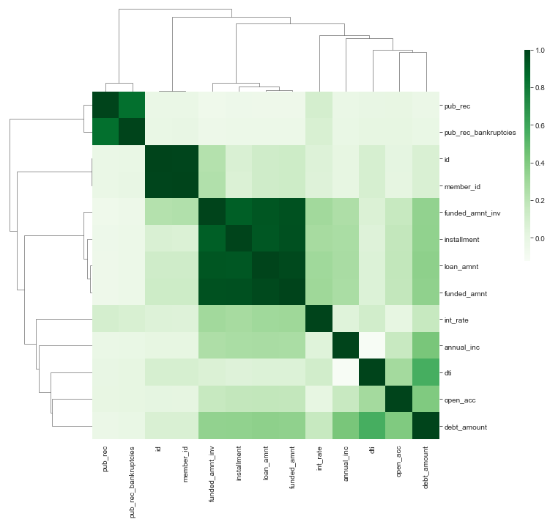
Correlation Plot
pub_rec_bankruptcies and pub_rec are highly correlated
annual_inc and loan amount are correlated
Both are together correlated with interest rate

Slide 25
Conclusions
Grades and Sub-Grade are one of the good metrics for finding loan defaulters. Lending club has to look into the information from borrowers before issuing loans to low grade like grade F & G.
Lending club should reduce the high interest rate for 60 months tenure, there are more chances for loan to get default.
Lending Club before approving loan should take a look at the DTI (Debt to Income ratio) of the applicants. As DTI of borrowers increases their tendency of defaults also increases.
Lending club should be more conscious when approving loans for applicants in the lower annual income segment, borrowers having annual income in range of 4k-50k has more of defaults.
When the loan amount higher the chance of applicants is defaulters. Lending club should properly analyze the applicants demanding higher loan.
Lending club should be more cautious when approving loan for the purpose of Small business, Debt consolidation ,Credit card and Education.
Loans having higher interest rate have more defaulters. Lending Club should check the background of applicant thoroughly if interest rate is high.
Lending Club should take extra security while approving applicants belonging to NE, NV, SD and AK state, as tendency to default is high.
If applicant employment length is >10 years Lending Club should thoroughly check applicants background as there are many defaulters in >10 years as an employment length.

